Slide 1
Lecture 14
Serialization

Slide 2
Introduction
Serialization is a class file which provides a fast and efficient way to store information produced by your application.
Example:
public class Address_Book
{
private String name="Billy bob";
private String number="000-000-0000";
private String address=“any street, in city";
}
Note: it is an address book, you will want to save this information somewhere on the phone. Your options are to output a text file with all of the information.

Slide 3
Introduction
Converting data to its serialized form is called marshaling it. Converting it back to its normal form is called deserializing or unmarshaling.
Data serialized for transmission over a network, may not need to be legible in flight.
Data serialized for storage in a database, however, will be far more useful if the representation permits SQL queries that are easy to construct and make sense.
Serialization format might be binary.

Slide 4
Four common uses of Serialization
Life cycle management
Persistence
Local inter-process communication
Network communication

Slide 5
Life cycle management
Unlike larger devices—laptop and desktop machines, for instance—Android devices cannot swap an application to a fast backing store when that application becomes inactive.
Android framework provides an object called a Bundle.
When an application is suspended it writes its state into the Bundle.
When the application is re-created the Android Framework promises to supply a copy of the same Bundle during its initialization.

Slide 6
Persistence
In addition to the immediate application state kept in a Bundle, most applications manage some kind of persistent data store. This data store is most likely an SQLite database wrapped in a Content-Provider.
In larger systems, this process—called object relational mapping (ORM).

Slide 7
Local inter-process communication
The Android Framework promotes an architecture that breaks larger, applications into smaller components: UI, content providers, and services. These components do not have access to each other’s memory space and must pass information across process boundaries as serialized messages.

Slide 8
Network communication
The ability to connect to the Internet and to use the incredible variety of services.
Applications need to be able to handle the protocols by any external service, which includes translating internal information into queries to services, and retranslating the response.

Slide 9
Java and Android Serialization
Java defines a serialization framework ObjectOutputStream and ObjectInputStream.
Android support Java serialization.
The Bundle type, has the pair of methods putSerializable and getSerializable.

Slide 10
Parcelable
Although the Android Framework supports Java serialization, it is usually not the best choice used as a Program State of local inter-process communication.
Parceable is the best choice for local inter-process communication.
Parceable is Android’s own internal serialization protocol.
Parcelable, is lightweight, highly optimized, and only slightly more difficult to use.

Slide 11
Classes That Support Serialization
Android Classes divided into four groups.
1. Simple types, consists of null, six primitives (int, float, etc.)
2. Consists of object types implementing Serializable or Parcelable.
3. Collection types, it contain arrays, lists, maps, bundles, and sparse arrays
(int[], float[], ArrayList<?>, HashMap<String, ?>,
Bundle<?>, SparseArray<?>, etc.).
4. Some Special Types: CharSequence and active objects (IBinder).
Note:
Always use variables that can actually be serialized.
Never change the class files source after you serialize a class file from it.
Do not use super large int[] arrays, it will avoid garbage wastage.

Slide 12
Serialization and Parcelable
Parcelable and Serialization are used for marshaling and unmarshaling Java objects.
Parcelable is well documented in the Android SDK but Serialization is available in Java.
In Parcelable, developers write custom code for marshaling and unmarshaling so it creates less garbage objects in comparison to Serialization.
Serialization is a marker interface as it converts an object into a stream using Java API. Due to this it ends up creating a number of garbage objects during the stream conversation process.
Performance of Parcelable over Serialization is around two times faster, because of this custom implementation.

Slide 13
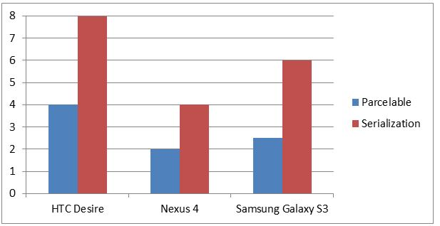
Speed Testing Results
The scale on the y-axis is the number of milliseconds it took Parcelable and Serialization to return results based on the API calls.

